Slide 1
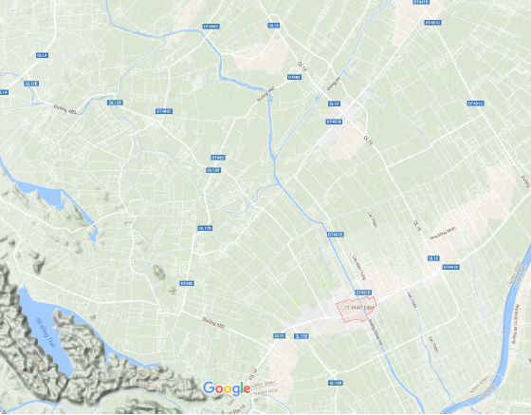
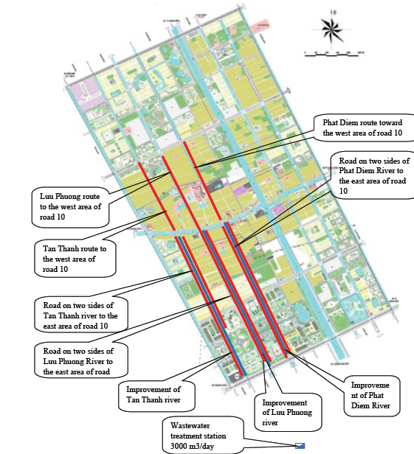
Phat Diem, Ninh Binh
Quick diagnostic:
Very flat area, naturally marshy with a
man made drainage network which efficiency is limited by the absence of slope.
Floods will remain a constraint and adapted urbanization (on pillar or local soil elevation) should be considered in the same time hydraulic infrastructure are improved.
Whatever the investment in infrastructure, flood will remain a constraint and living with flood an efficient strategy.

Slide 2
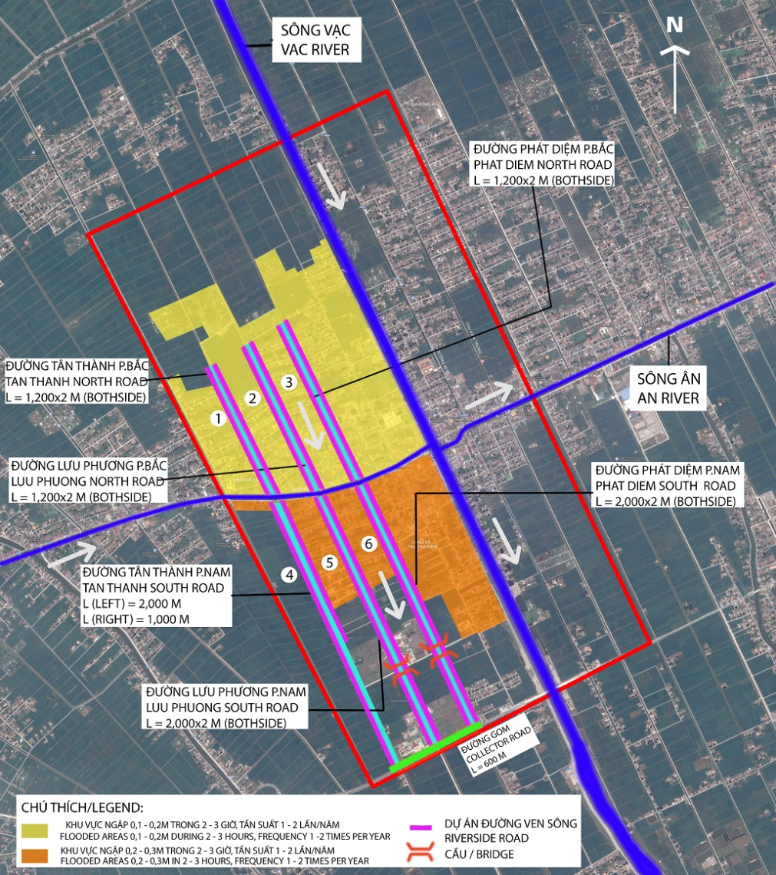
Phat Diem – flood risk and drainage management
  City very sensitive to flood (low ground level)
  Proposed drainage infrastructures well designed and adapted
  Several infrastructures on canals (such as bridges) reducing the hydraulic capacity – an hydraulic modeling may help to understand better their impacts

Slide 3
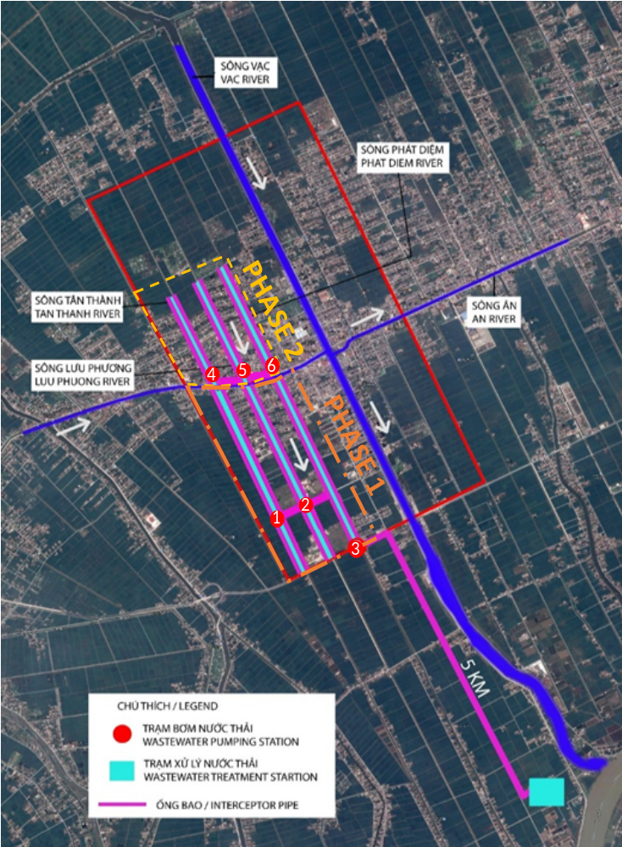
Phat Diem - wastewater
  Due to city topography, high infiltration water flow to be expected
  Recommendations:
    Pumping stations to cross canals (no siphon)
    Phasing of investment
    Simple process (such as lagoon) for WWTP (cheaper and easier to operate)
    Consider septage co-treatment to the WWTP

